Slide 1
Cassandra @ Rackspace Metrics

Slide 2
Cassandra @ Rackspace Metrics
Tilottama Gaat, Software Developer III,
Gaurav Bajaj, Software Development Intern
Alexander Scammon, Sr. Engineering Manager
Rackspace, San Francisco
Notes:
We just launched Managed Cassandra
About Managed Cassandra:
It’s for all you people who do not want to manage Cassandra themselves
The reason is that we have managed Cassandra at the Rack is because we have a lot of operational exp with Cassandra, we are one of those teams. We gonna describe one of the situations that taught us a lot about operating Cassandra.

Slide 3
1 | Rackspace Metrics & Blueflood
2 | How Cassandra powers Blueflood
3 | Compaction Strategies Burn
4 | Managed Cassandra @ Rackspace

Slide 4

Rackspace Metrics & Blueflood
blueflood.io
open source, multi-tenanted, distributed system for large scale time-series data
elevator pitch: scalable backend for graphite, grafana and other dashboards
elevator pitch #2: blueflood provides a simple API for metrics storage and retrieval
Ingest, Query and Rollup metrics
Cassandra - backend store for Blueflood
Rackspace Metrics
Blueflood as a Service
Used internally and externally
Ingest ~7M metrics per min

Slide 5
How Cassandra powers Blueflood
32 nodes in Cassandra ring
Cassandra 2.0
Replication factor = 3, Consistency level = 1
Only in 1 DC (IAD), but multi-DC soon
Total data: ~20TB

Slide 6
How Cassandra powers Blueflood
ts0
ts1
ts10565
56
1.cpu.load_avg
45
42
Wide Rows!
Key – metric name
Column -- timestamp

Slide 7
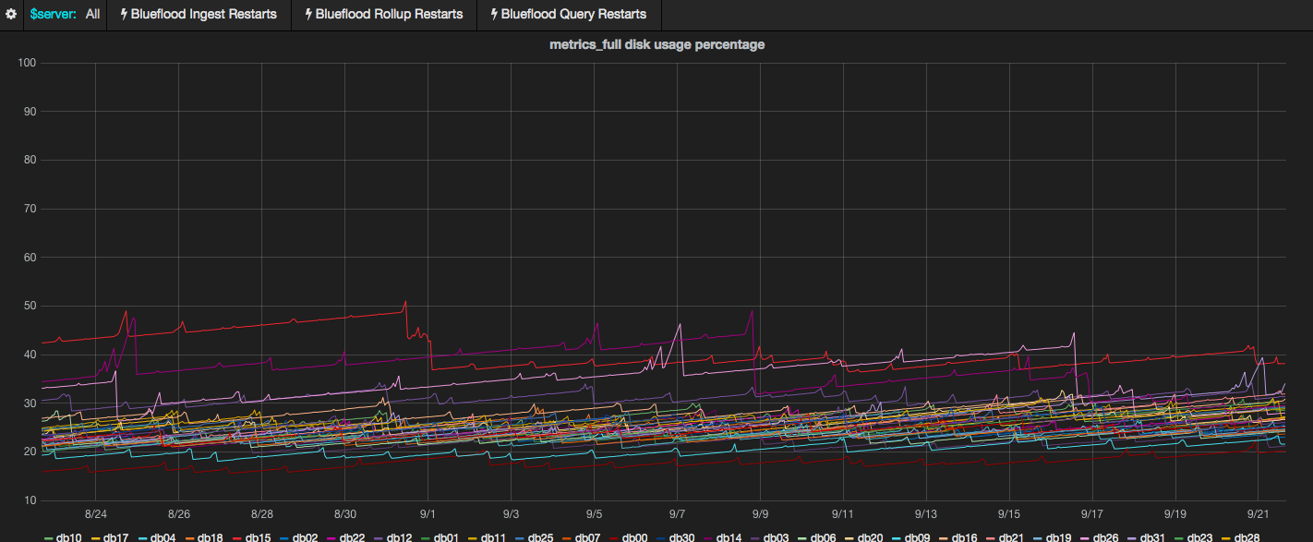
Disk Usage Graphs
Current overall state – Good!
Notes:
Best practices guides of Cassandra advise that disks only need to be 40% full.
And that is what we have currently.. The reason for that is to be shown in the next slides

Slide 8
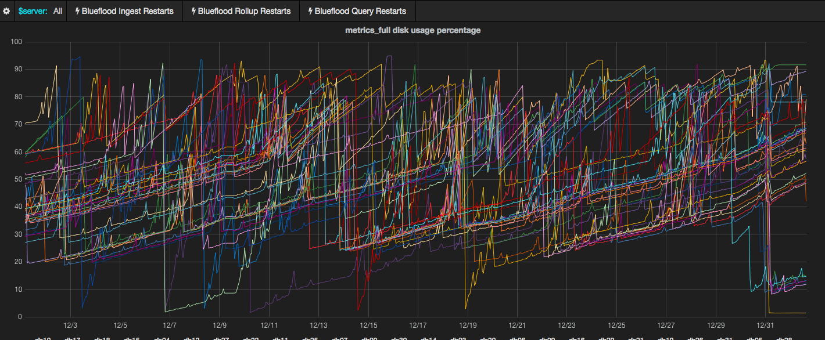
Disk Usage Graphs
Dec 2014 overall state – Bad!

Slide 9
Cassandra Disk Usage
40% Best Practice
Our supposed usage: ~25%

Slide 10
Disk Usage factors
Data size
TTL
GC_GRACE
ts0
ts1
ts10565
56
1.cpu.load_avg
45
42
Waiting for compaction
Beyond ttl+gc_grace
Beyond ttl
Notes:
TODO: Add picture to show

Slide 11
Size Tiered Compaction Strategy
sstable1
sstable2
sstable3
sstable4
sstable12
sstable34
sstable1234

Slide 12
Caveats to STCS
The Big Problem:
If even a single column in a row is current, do not drop it
The Saving Grace:
If all the rows in an sstable are tombstoned and past gc_grace, then it is OK to drop the whole sstable

Slide 13
Size Tiered Compaction Strategy – Best Case
sstable1
sstable2
sstable3
sstable4
sstable12
sstable34

Slide 14
Size Tiered Compaction Strategy – Worst Case
sstable1
sstable2
sstable3
sstable4
sstable12
sstable34
sstable1234

Slide 15
Combating the Problems
Throw space at the problem
Lower GC_GRACE
Run user-defined compactions
Switch to DTCS

Slide 16
Introducing Managed Cassandra Powered By DataStax
Easy
Configuration, Management and Scaling made easy
Optimized
Optimized solutions for your workload
Fully Managed
Our experts have you covered
Learn More about Solving the Complexities of Modern Applications at Scale
Register for our webinar on 10/27, 9am PST / 11am CST
@ bit.ly/1FPSF91

Slide 17

Top Challenges – Enterprise Cassandra
Complex
Risk
Performance
Architecture & Design
Support
Maximize Performance
Difficult to acquire expertise necessary to architect and manage Cassandra solutions
Risky to build and secure Cassandra applications at scale to process transactions.
Challenging to deploy a vertically integrated stack optimized for performance.

Slide 18
Compaction Strategies Burn
Expected disk usage pattern

Slide 19
Seen disk usage pattern

Slide 21
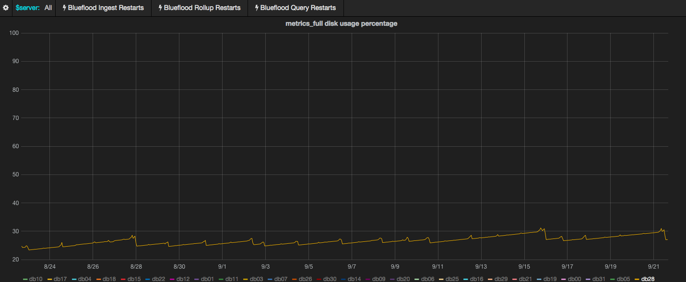
Real Graphs
Current db28 state – Great!

Slide 22
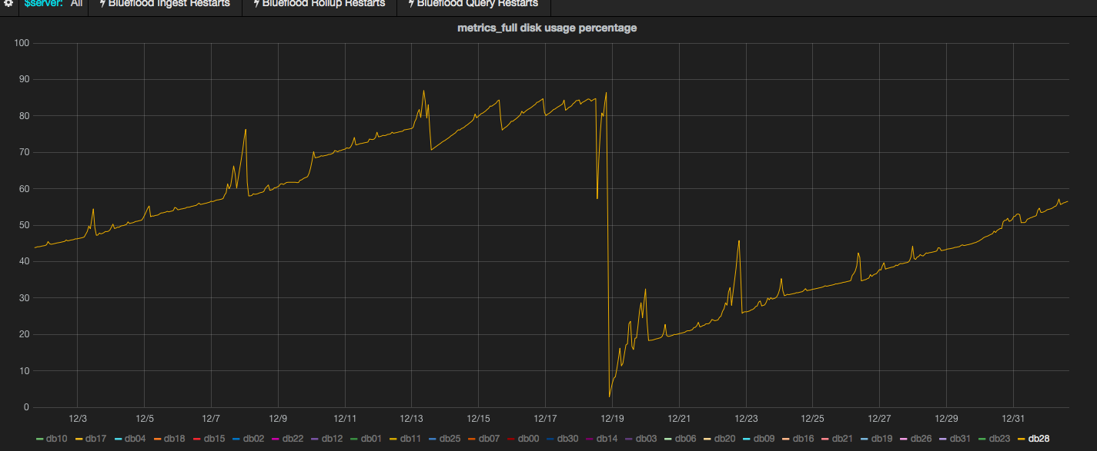
Real Graphs
Dec 2014 db28 state – ☹

